Slide 1


Rockbuster Stealth LLC Data Analysis
Business Strategy for 2020
by
Atika AhmedSudi

Slide 2


Content Page
Introduction
Data Overview
High Revenue
Rating by Genres
Countries where Rockbuster customers are based
Countries with the highest number of customers
Countries with the highest revenue?
MPAA Rating
Conclusion
Recommendation

Slide 3

Introduction
Rockbuster Stealth LLC is aiming to stay competitive in the era of streaming services and plans to establish an internet-based movie rental platform in 2020. To achieve this goal, the company will leverage its existing film licenses and employ its expertise in Data Analysis to derive valuable insights. These insights will assist the business intelligence department in formulating a robust strategy for a successful launch.

Slide 4


Overview
Number of Films:
1000
Number of Languages:
1 (English)
Release Year of All Films:
2006
Min Rental Duration (days):
3
Max Rental Duration (days):
7
Avg Rental Duration (days):
4.985
Min Rental Rate:
$0.99
Max Rental Rate:
$4.99
Avg Rental Rate:
$2.98
Min Movie Length (min):
46
Max Movie Length (min):
185
Avg Movie Length (min):
115
Min Replacement Cost:
$9.99
Max Replacement Cost:
$29.99
Avg Replacement Cost:
$19.98

Slide 5
Top 10 Highest Movie Revenue
These films have generated enormous money, adding considerably to the overall success of Rockbuster's film catalogue. Each of these films has made significant cash, contributing significantly to the overall success of Rockbuster's film catalogue.
Film ID | Movie | Genre | Revenue
730 | Ridgemont Submarine | New | $110.72
892 | Titanic Boondock | Animation | $149.78
286 | Enough Raging | Travel | $51.84
664 | Patriot Roman | Action | $52.85
550 | Maguire Apache | Family | $33.91
504 | Kwai Homeward | Drama | $42.8
580 | Mine Titans | New | $138.83
982 | Women Dorado | Action | $38.81
315 | Finding Anaconda | Family | $26.9
992 | Wrath Mile | Documentary | $22.87

Slide 6
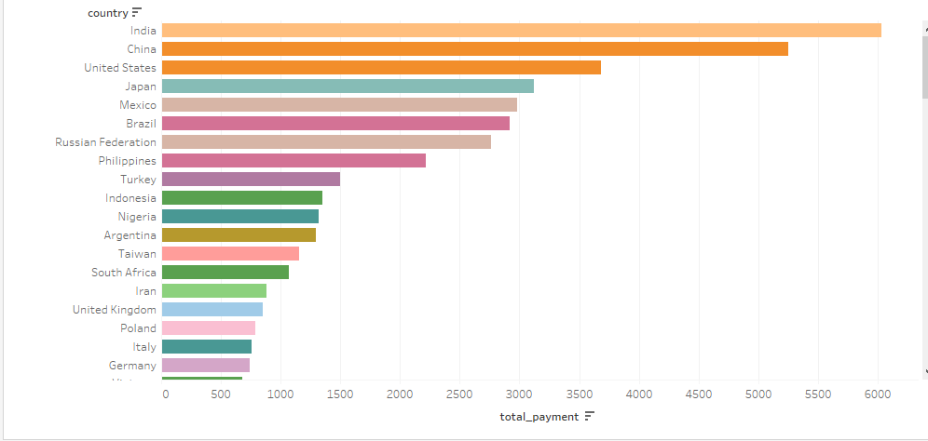
Countries with the highest Revenue
According to the analysis, Countries with the highest revenues are:
India
China
USA
Japan
Mexico

Slide 7
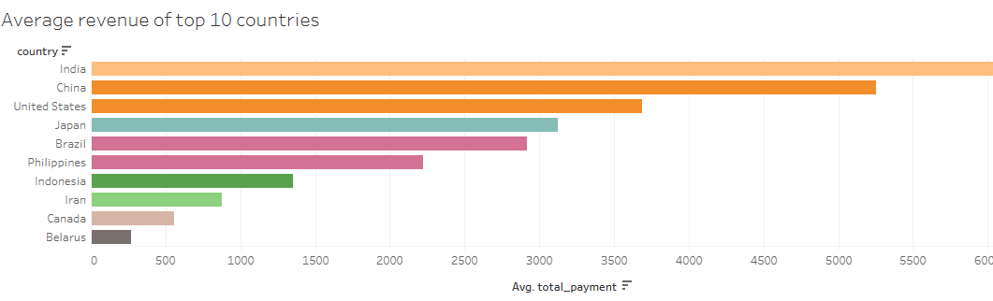
Average revenue of top 10 countries
According to the analysis the countries with the averages revenue are:
India
China
USA
Japan
Brazil

Slide 8
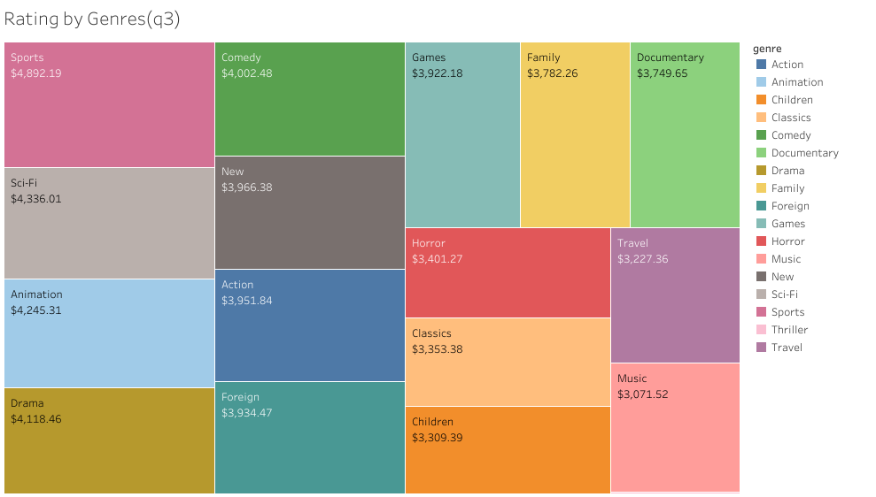
Rating by Genres
The following are the most popular genres based on revenue analysis:
Sports
Sci-Fi
Animation
Drama
Comedy

Slide 9
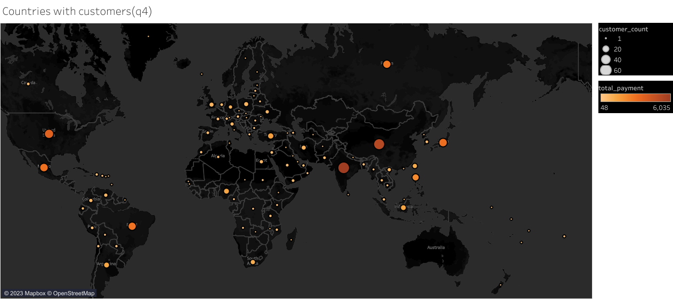
Countries where customers are based
Gaining insights into customer demographics and preferences is paramount for creating a robust online catalogue. By conducting revenue and geographical analysis, organizations can effectively target customers across the globe, thus establishing a thriving online presence.

Slide 10

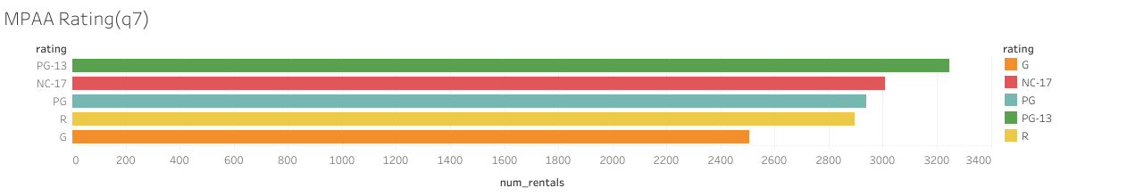
MPAA Ratings
After analysing rental rates, it was discovered that PG-13 films are the most popular among customers, while G-rated films are the least popular. The MPAA rating of PG-13 provides the highest money, followed by NC-17, PG, and R. However, no major difference exists, and G grading cannot be ruled out.

Slide 11

Conclusion
Rockbuster Stealth LCC has a diverse customer base spanning the globe.
Notable revenue drivers and high lifetime value are found in India, China, Japan, Mexico, and the United States.
Popular genres vary across these countries:
"Sports" is favoured in India, the United States, and Mexico.
"Animation" is favoured in China.
"New" is favoured in Japan.
The primary movie ratings for films released in 2006 are PG-13 and NC-17.
While the majority of consumers are located in India and China, Rockbuster Stealth LLC has a presence in 109 countries worldwide.
The genres that generate the highest revenue include sports, science fiction, animation, drama, and comedy films.

Slide 12
Recommendations
Key points:
Adding foreign language films, with a focus on Chinese dialects and Indian.
Prioritizing marketing efforts in India, China, the US, Japan, and Mexico.
Focusing on sports, sci-fi, animation, drama, and comedy films.
Implementing customer loyalty programs to reward top customers.

Slide 13

Tableau link here: Rockbuster | Tableau Public

